Slide 1
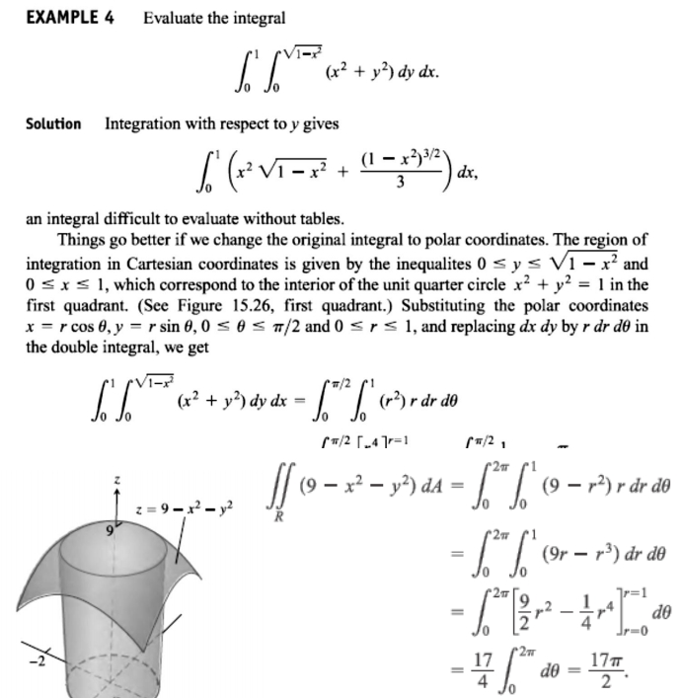
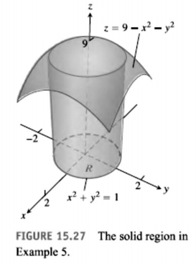
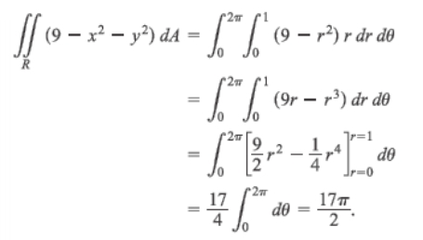
12 / Dep. Of Engineering Mechanics
th
Class: 2 AMTHMATICS / Multiple Integrals

Slide 2
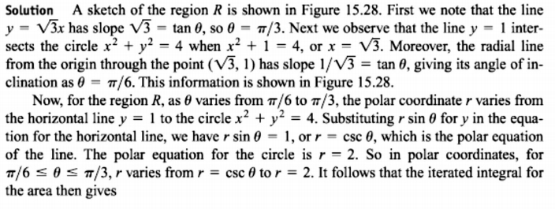
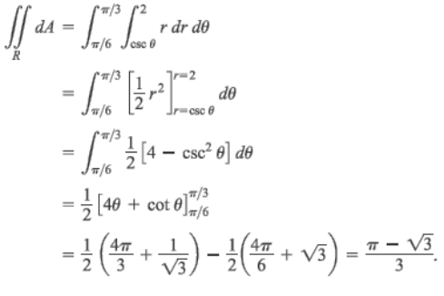
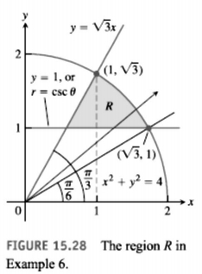
13 / Dep. Of Engineering Mechanics
th
Class: 2 AMTHMATICS / Multiple Integrals

Slide 3
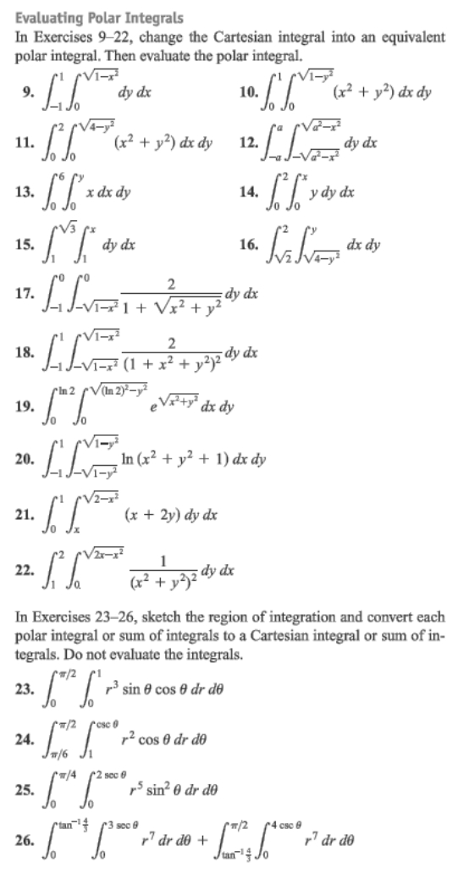
14 / Dep. Of Engineering Mechanics
th
Class: 2 AMTHMATICS / Multiple Integrals

Slide 4
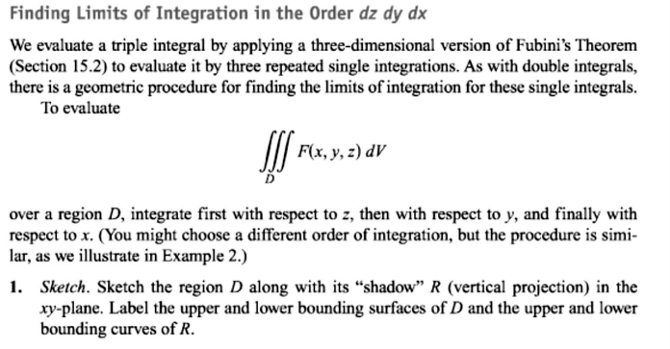
15 / Dep. Of Engineering Mechanics
th
Class: 2 AMTHMATICS / Multiple Integrals

Slide 5
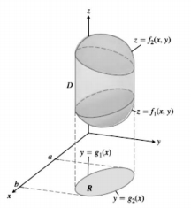
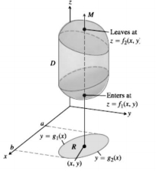
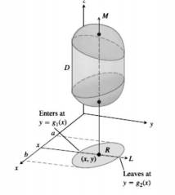
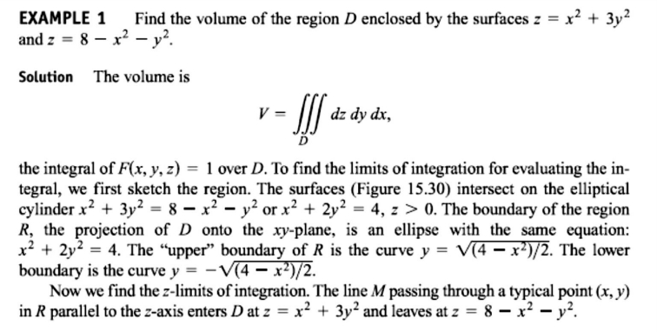
16 / Dep. Of Engineering Mechanics
th
Class: 2 AMTHMATICS / Multiple Integrals
1
2
3

Slide 6
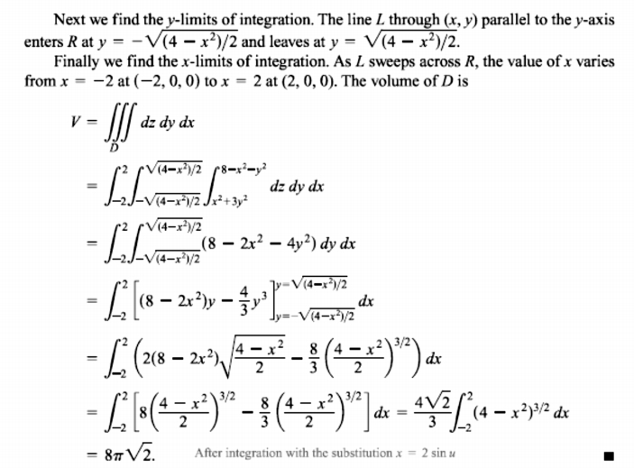
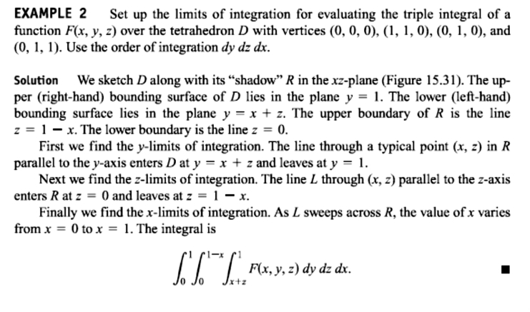
17 / Dep. Of Engineering Mechanics
th
Class: 2 AMTHMATICS / Multiple Integrals

Slide 7
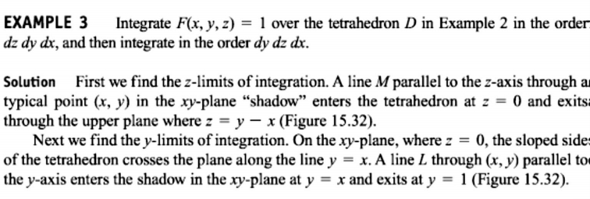
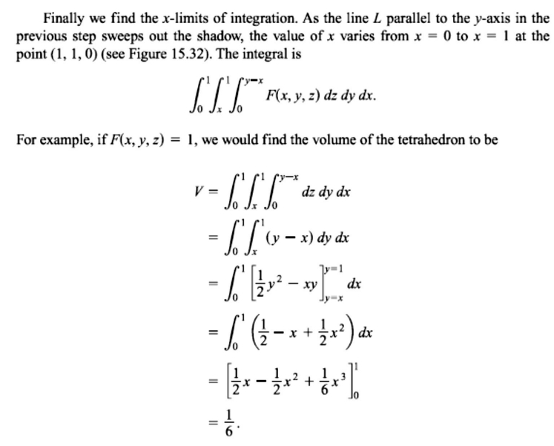
18 / Dep. Of Engineering Mechanics
th
Class: 2 AMTHMATICS / Multiple Integrals

